Slide 1
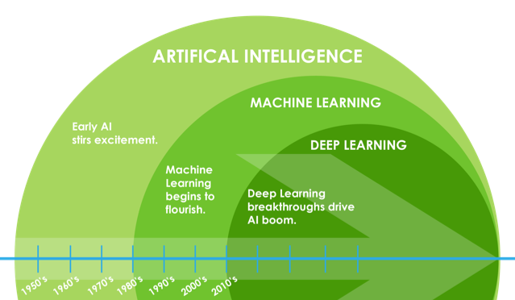

Slide 2


Slide 3

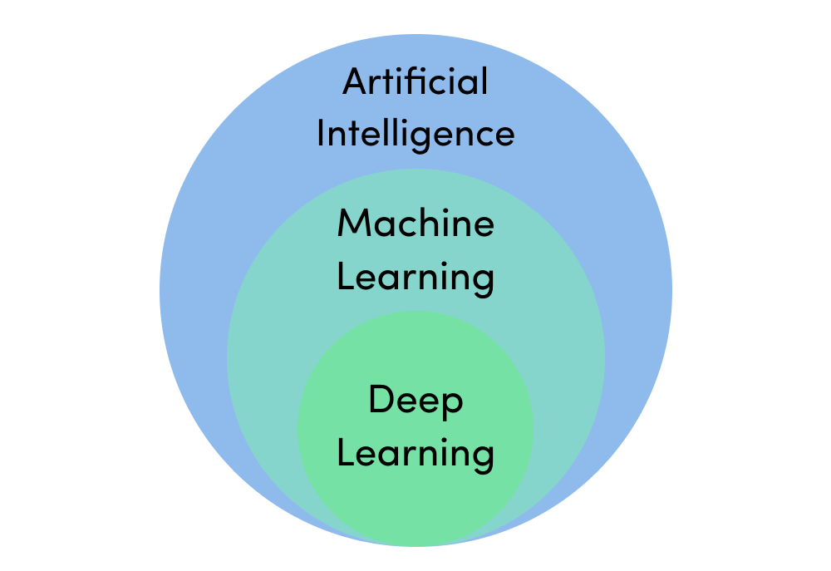
Deep Learning
Invented in the 40s.
Caught on the trend in the 80s
Research in this area, it slowly died of in the next decade.
Reasons:
Not that good in predicting things.
Technology back then wasn’t up to the right standard to facilitate neural networks
We need a lot of data and processing power for the neural network to work properly.

Slide 4
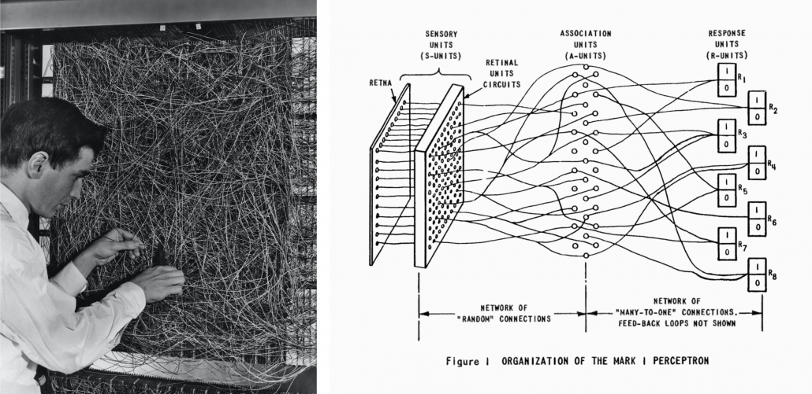
Frank Rosenblatt with Perception & ANNs from Neural Networks and Deep Learning
(Source: towardsdatascience.com)

Slide 5
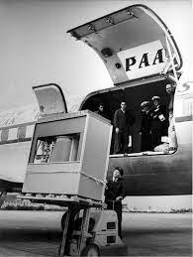
Storage evolved
1956
5 MB Hard drive
2500$ to rent for a month

Slide 6
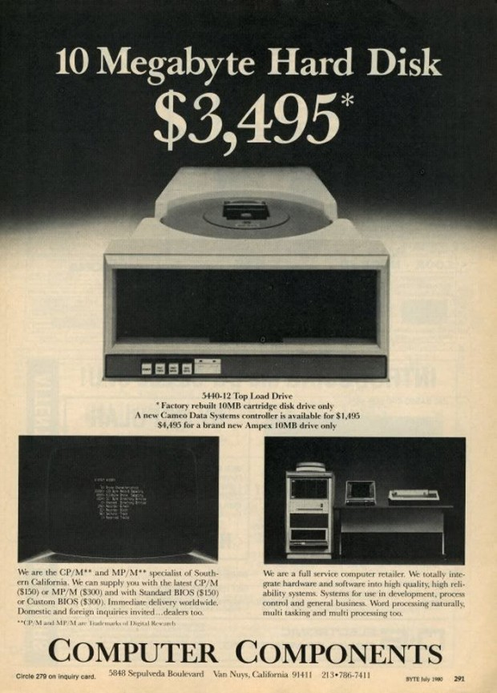
Storage evolved
1956
1980
5 MB Hard drive
2500$ to rent for a month

Slide 7

Storage evolved
1956
1980
2022 (Present)
5 MB Hard drive
2500$ to rent for a month

Slide 8
Storage evolved
1956
1980
2022 (Present)
5 MB Hard drive
2500$ to rent for a month

Slide 9
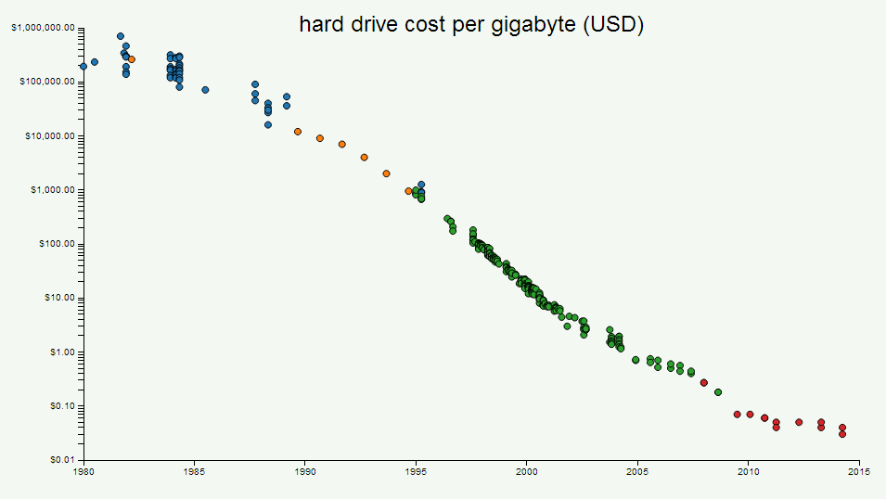
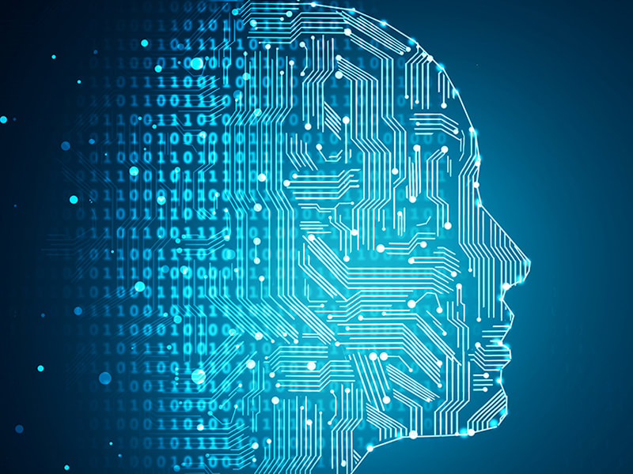

Slide 10
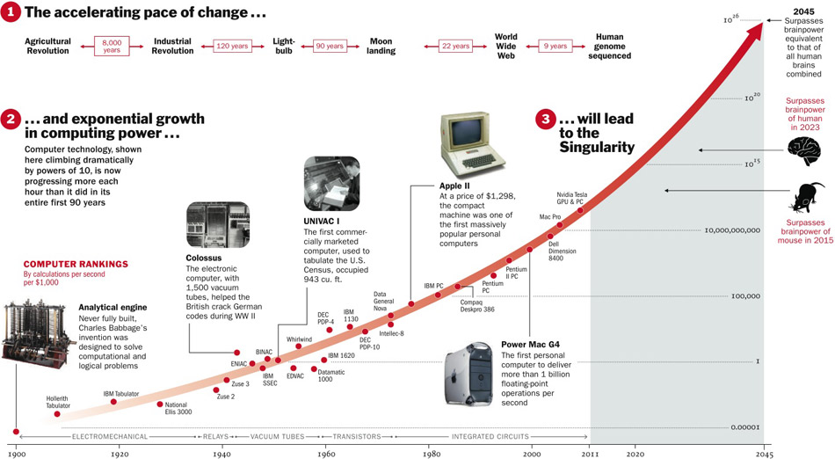
Moore’ Law

Slide 11
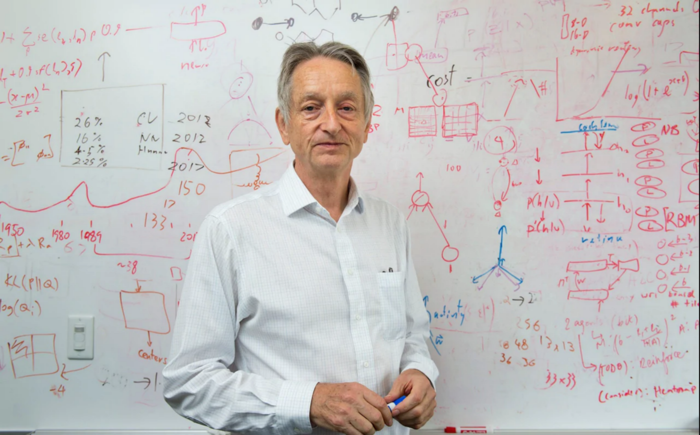
Geoffrey Hinton – Did research in deep learning in the 80s.

Slide 12
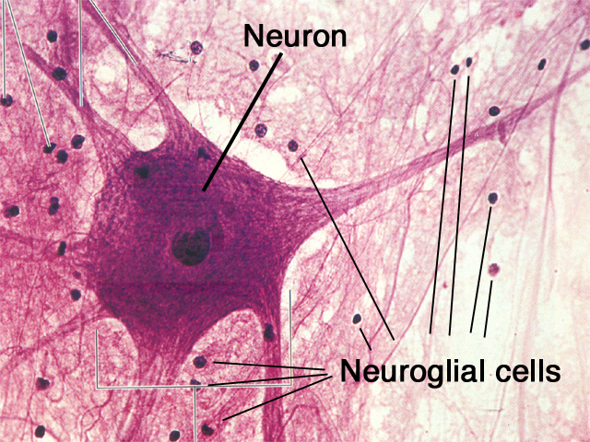
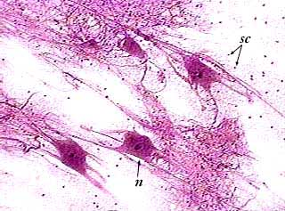
Mimic how the human brain operates.
Human brain can learn, adapt skills and apply them.
Approximately 100 billion neurons in human brain. Each connected to a 1000 of its neighbors.

Slide 13
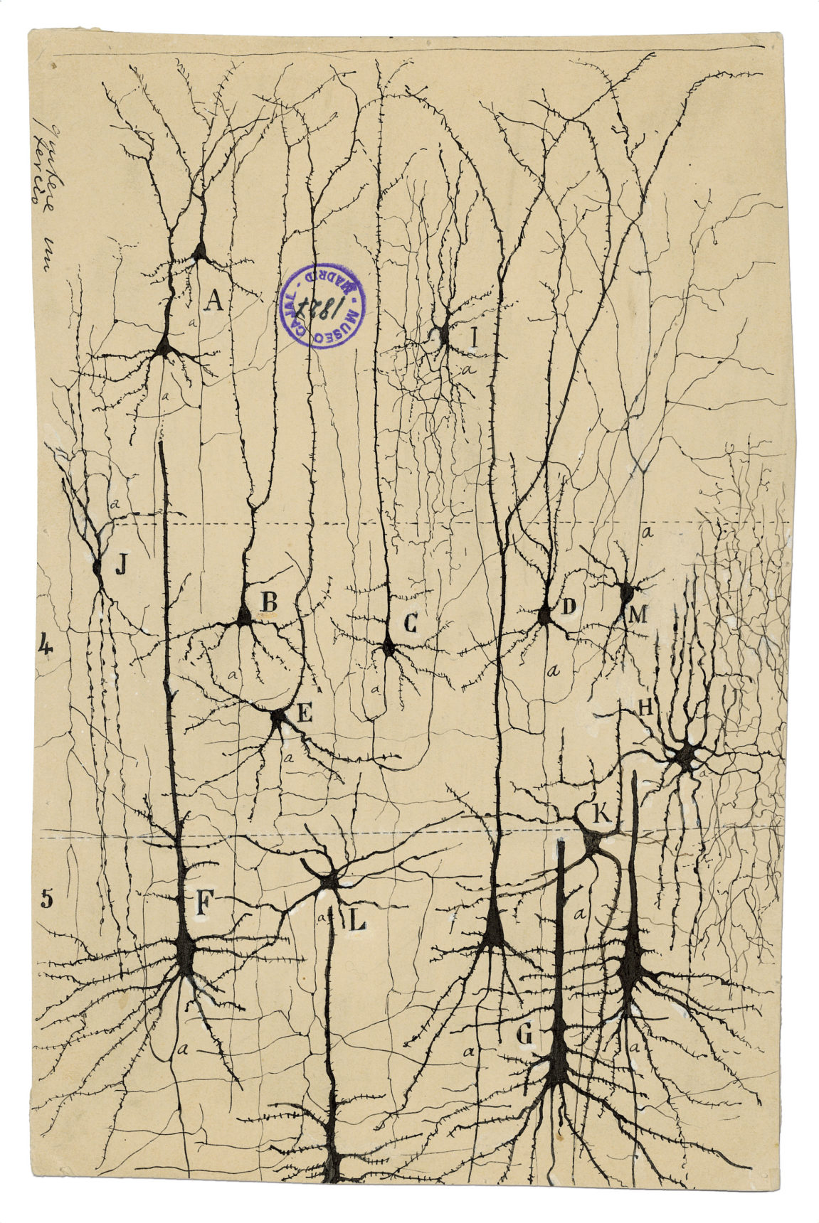

Slide 14
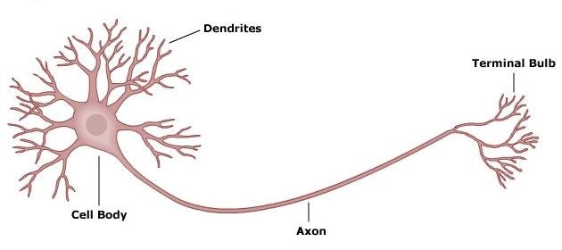
The neuron

Slide 15
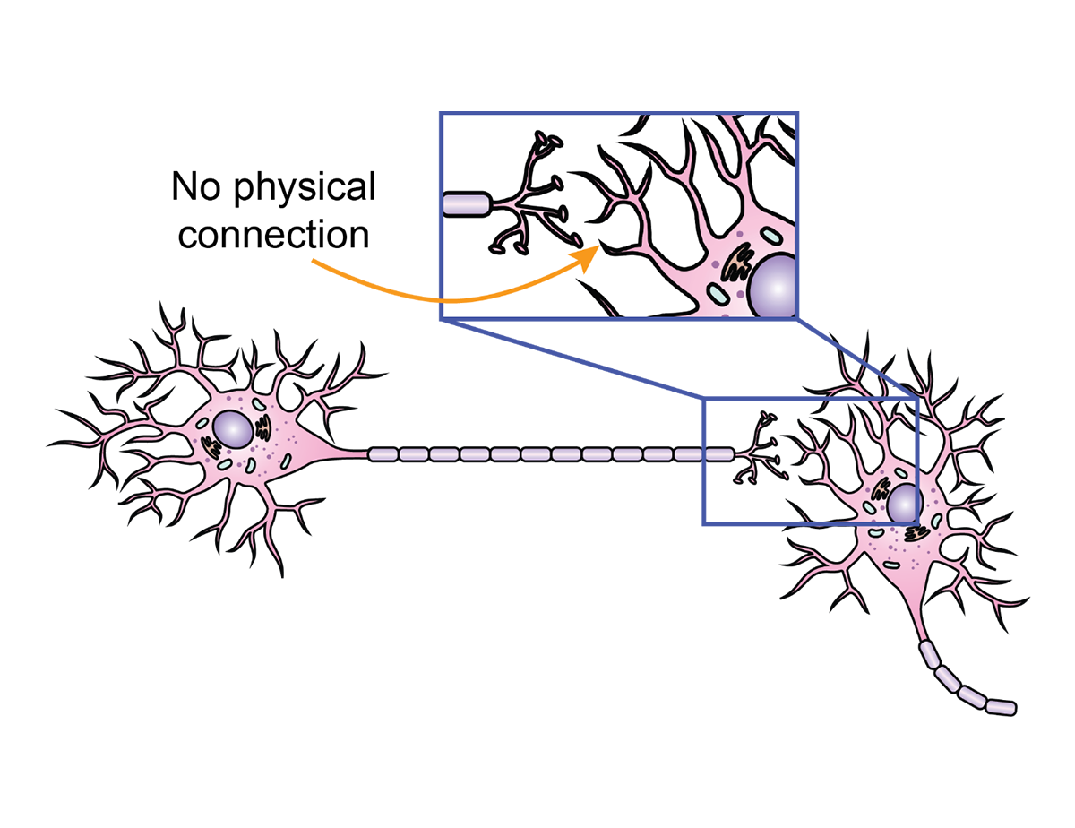
Deep Learning

Slide 16
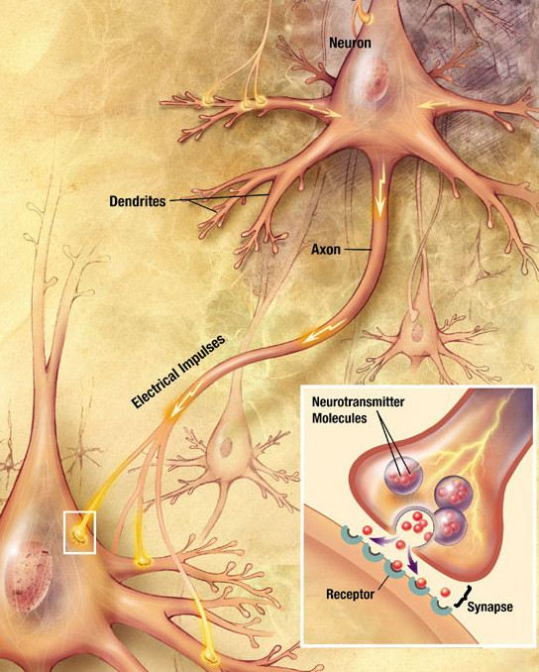
Deep Learning

Slide 17
Input value 1
Input value 2
Input value 3
Input Layer

Slide 18
Input value 1
Input value 2
Output value
Input value 3
Input Layer
Output Layer

Slide 19
Input value 1
Input value 2
Output value
Input value 3
Input Layer
Hidden Layer
Output Layer

Slide 20
Input value 1
Input value 2
Output value
Input value 3
Input Layer
Hidden Layer
Output Layer

Slide 21
Input value 1
Input value 2
Output value
Input value 3
Input Layer
Hidden Layer
Output Layer

Slide 22
Input value 1
Input value 2
Output value
Input value 3
Input Layer
Hidden Layer
Output Layer

Slide 23
Input value 1
Input value 2
Output value
Input value 3
Input Layer
Hidden Layer
Output Layer

Slide 24
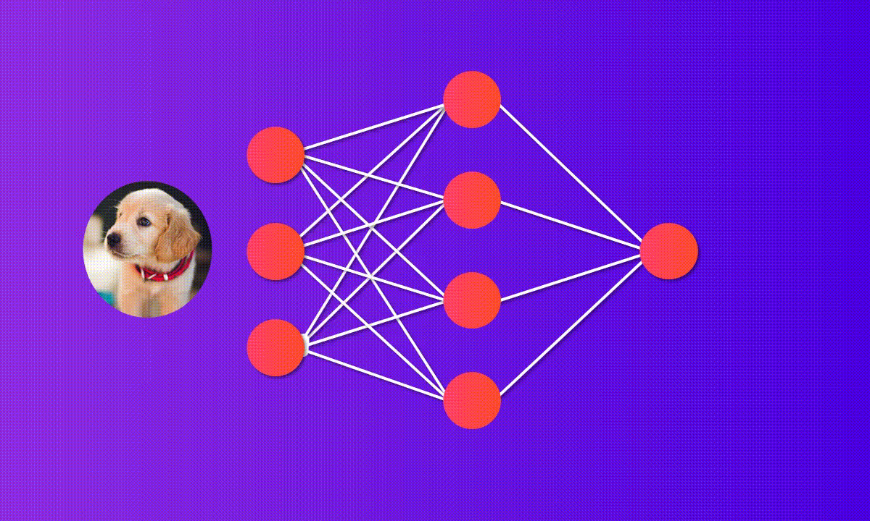
Source: Towards Data Science - How to build your own Neural Network from scratch in Python.

Slide 25
Input value 1
Input value 2
Output value
Input value 3
Input Layer
Hidden Layer
Output Layer

Slide 26
Input value 1
Input value 2
Output value
Input value 3
Input Layer
Hidden Layer
Output Layer

Slide 27
Input value 1
Input value 2
Output value
Input value 3
Input Layer
Hidden Layer
Output Layer

Slide 28
Input value 1
Input value 2
Output value
Input value 3
Input Layer
Hidden Layer
Output Layer

Slide 29
Abstract
Input value 1
Input value 2
Output value
Input value 3
Input Layer
Hidden Layer
Output Layer

Slide 30
Independent variable 1
X1
Neuron
Independent variable 2
X2
y
Output value
Independent variable 3
X3

Slide 31
If y is categorical variable
y1
Independent variable 1
X1
Neuron
y2
Independent variable 2
X2
Output values
Independent variable 3
X3
y3

Slide 32
Neuron
Independent variable 1
X1
∑w_{i}x_{i}
Independent variable 2
X2
y
Output value
Independent variable 3
X3

Slide 33
Activation Function
Neuron
Independent variable 1
X1
∅(∑w_{i}x_{i})
Independent variable 2
X2
y
Output value
Independent variable 3
X3

Slide 34
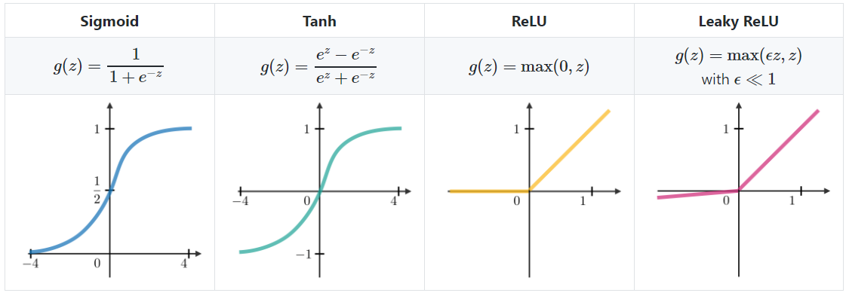
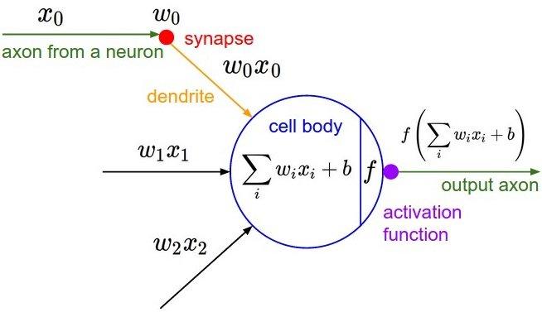
Source: Predictive Analysis of Employee Loyalty: A Comparative Study Using Logistic Regression Model and Artificial Neural Network.

Slide 35
Source: A gentle introduction to deep learning in R using by Keras
Ladislas Nalborczyk

Slide 36
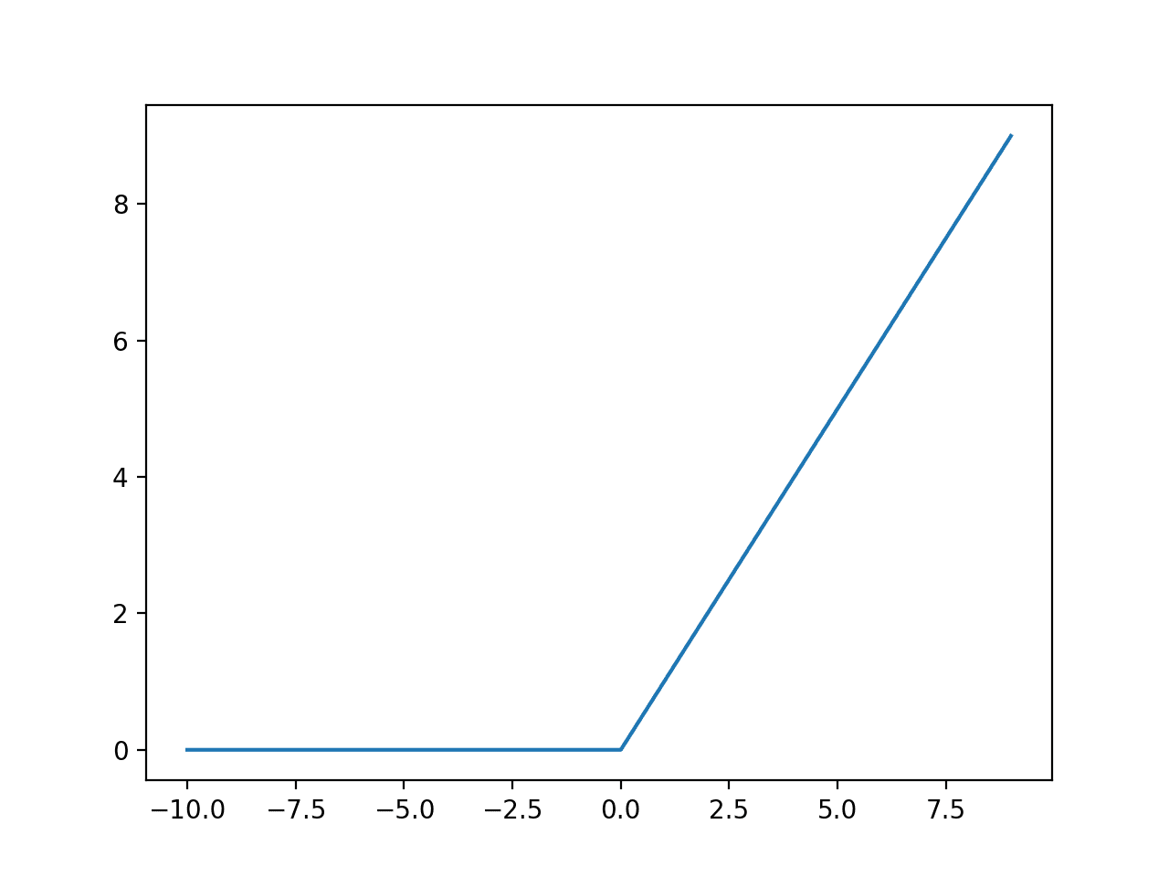
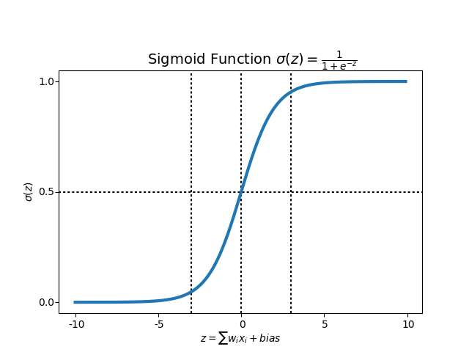
Input value 1
Input value 2
Output value
Input value 3
Input Layer
Hidden Layer
Output Layer

Slide 37
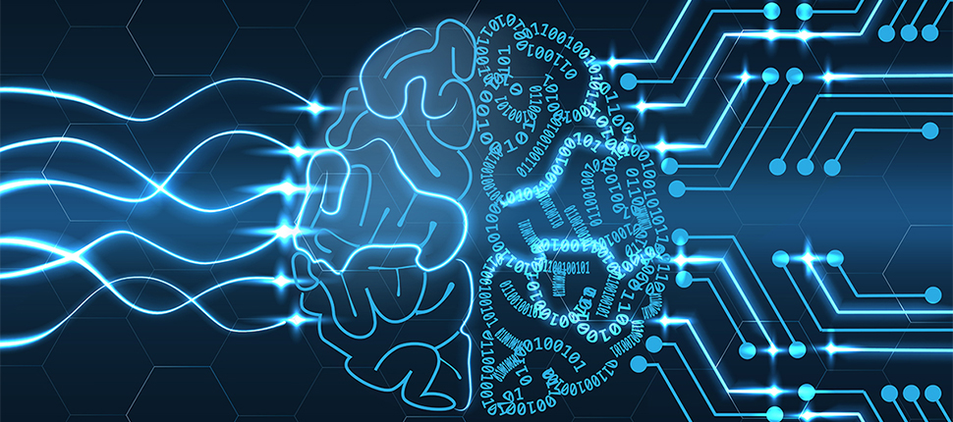
How do NNs learn?
We provide input and let it know what we want as output. The NN learns everything on its own.

Slide 38
Source: A gentle introduction to deep learning in R using by Keras
Ladislas Nalborczyk

Slide 39
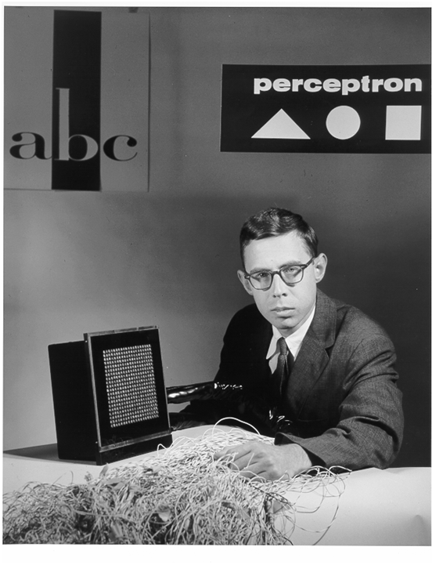
Frank Rosenblatt
1958

Slide 40
Perceptron
Independent variable 1
X1
W1
∅(∑w_{i}x_{i})
Independent variable 2
X2
W2
ŷ
Predicted value
.
.
.
W3
Independent variable m
Xm
y
Actual Value

Slide 41
Perceptron
Independent variable 1
X1
W1
∅(∑w_{i}x_{i})
Independent variable 2
X2
W2
ŷ
Predicted value
.
.
.
W3
Independent variable m
Xm
y
Actual Value

Slide 42
Perceptron
Independent variable 1
X1
W1
∅(∑w_{i}x_{i})
Independent variable 2
X2
W2
ŷ
Predicted value
.
.
.
W3
Independent variable m
Xm
y
Actual Value

Slide 43
Perceptron
Independent variable 1
X1
W1
∅(∑w_{i}x_{i})
Independent variable 2
X2
W2
ŷ
Predicted value
.
.
.
W3
Independent variable m
Xm
y
Actual Value

Slide 44
Perceptron
Independent variable 1
X1
W1
∅(∑w_{i}x_{i})
Independent variable 2
X2
W2
ŷ
Predicted value
.
.
.
W3
c = ½(ŷ-y)²
Independent variable m
Xm
y
Actual Value

Slide 45
Perceptron
Independent variable 1
X1
W1
∅(∑w_{i}x_{i})
Independent variable 2
X2
W2
ŷ
Predicted value
.
.
.
W3
Independent variable m
Xm
y
Actual Value

Slide 46
Perceptron
Independent variable 1
X1
W1
∅(∑w_{i}x_{i})
Independent variable 2
X2
W2
ŷ
Predicted value
.
.
.
W3
Independent variable m
Xm
y
Actual Value

Slide 47
Perceptron
Independent variable 1
X1
W1
∅(∑w_{i}x_{i})
Independent variable 2
X2
W2
ŷ
Predicted value
.
.
.
W3
Independent variable m
Xm
y
Actual Value

Slide 48
Perceptron
Independent variable 1
X1
W1
∅(∑w_{i}x_{i})
Independent variable 2
X2
W2
ŷ
Predicted value
.
.
.
W3
Independent variable m
Xm
y
Actual Value

Slide 49
Gradient Descent
c = ½(ŷ-y)²

Slide 50
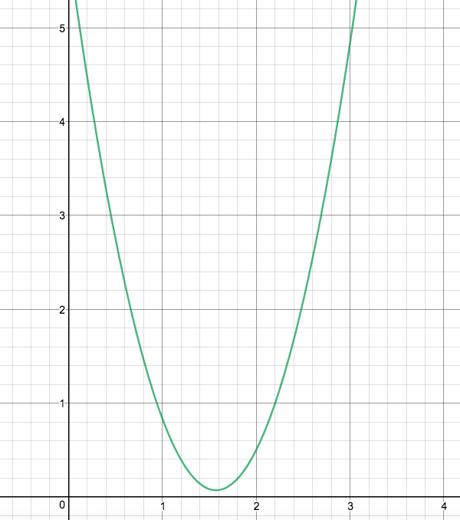
Gradient Descent
c = ½(ŷ-y)²
ŷ

Slide 51
Input value 1
Input value 2
Output value
Input value 3
Input Layer
Hidden Layer
Output Layer

Slide 52
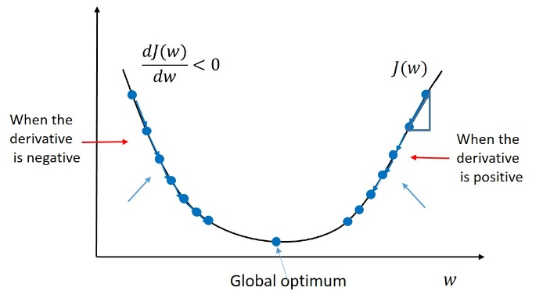
Gradient Descent
c = ½(ŷ-y)²
Best!
ŷ

Slide 53
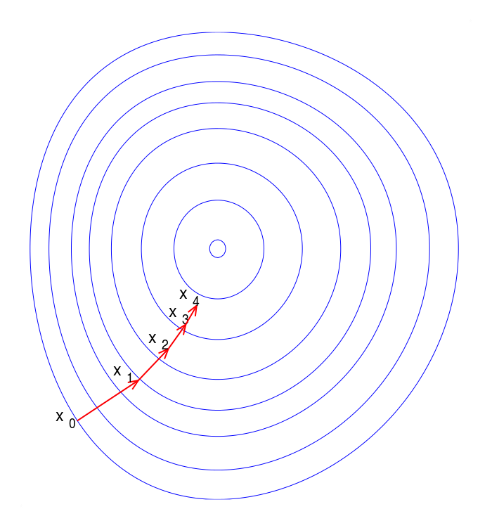
Gradient Descent
2D
ŷ

Slide 54
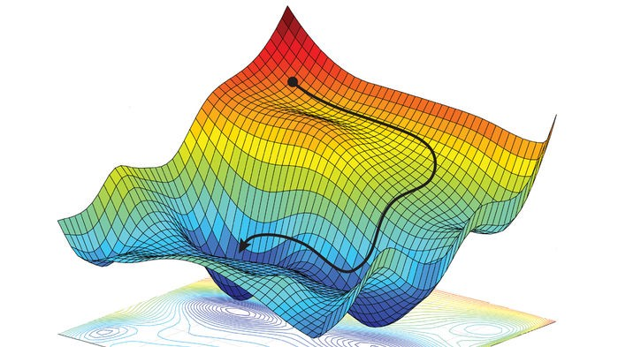
Gradient Descent
3D
ŷ

Slide 55
Gradient Descent
c = ½(ŷ-y)²
ŷ

Slide 56
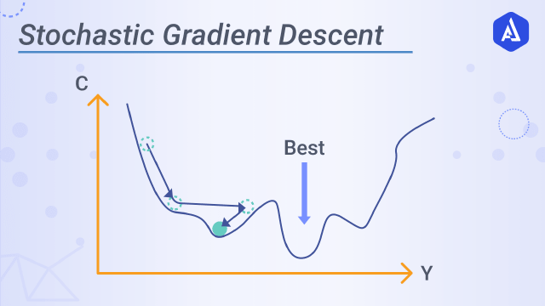
Stochastic Gradient Descent
Source: Akira AI

Slide 57
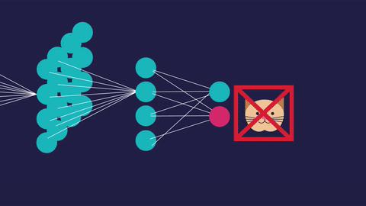
Back propagation
Source: Analytics Vidhya

Slide 58
Training the ANN with Stochastic Gradient Descent
Step 1: Randomly initialize the weights to small numbers close to zero(not exactly 0).
Step 2: Input the first observation of dataset in the input layer, each feature in one input node.
Step 3: Forward Propagation: From left to right, the neurons are activated in such a way that the impact of each neuron’s activation is limited by weights. Propagate the activations until getting the predicted result ŷ .
Step 4: Compare ŷ to y. Measure the generated error.
Step 5: Back-propagation: from right to left, the error is back propagated. Update the weights according to how much they are responsible for the error. The learning rate decides by how much we update the weights.
Step 6: Repeat steps 1 to 5 and update the weights after each observation(Reinforcement Learning) .
Or Repeat steps 1 to 5 but only update the weights after a batch of observations(Batch Learning).
Step 7: When the whole training set is passed through the ANN, that makes an epoch. Redo more epochs.
Source: Udemy-Machine Learning A-Z™: Hands-On Python & R In Data Science

Slide 59
Back propagation
Source: Analytics Vidhya

Slide 60
Back propagation
Source: Analytics Vidhya

